Slide 1

Generations
Group members: Gabriel Gietzel, Gabriel Sandu Gabriel Cesar, Murilo Furlaneto and Victor Daderio

Slide 2

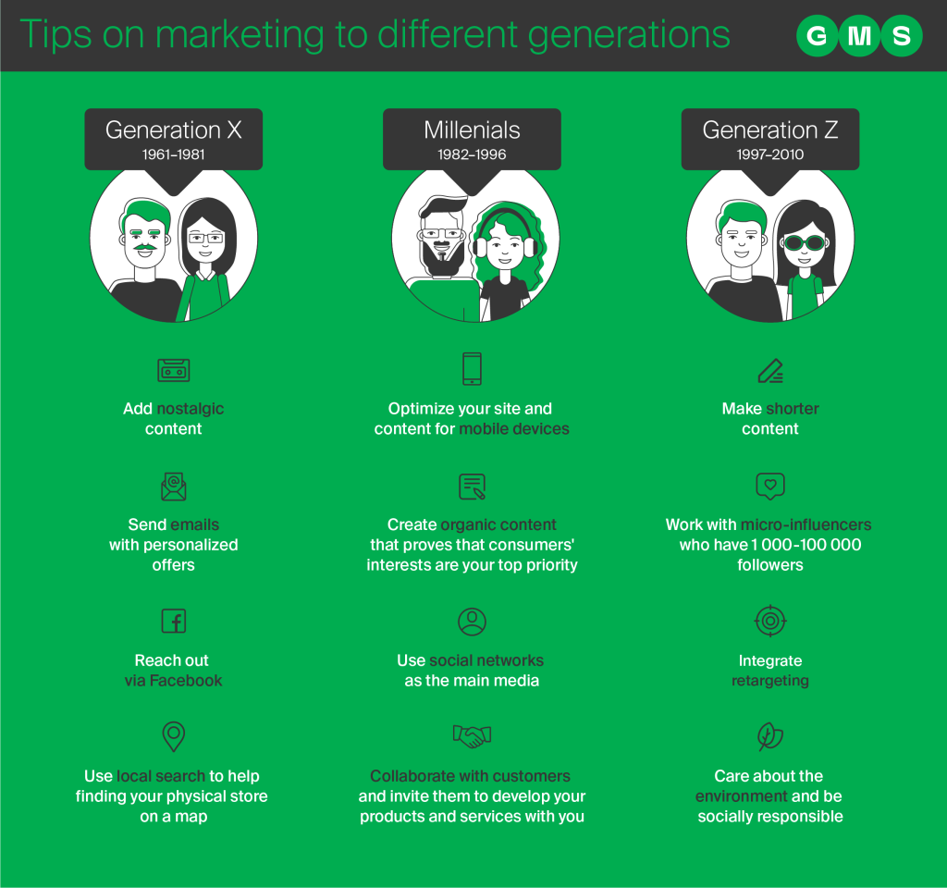
Website content
Did the websites get it right?
I think that they’ve made a great prediction right there, by searching up like: How can we reach this generation? Do they usually use this info medium? What attracts the eyes of this generation? What keeps this person entertained and receptive? For me, there are things that looks like facts, the personalized advertisement on the Facebook for the Millennials and also for the Gen X (I believe that is the main social media of them as well), based on lifestyle brands and nostalgic content. These two articles kinda make sense tough.

Slide 3


Social media Content
There’s a vídeo called by: “Gerações X, Y e Z: Qual É A Sua?” It portrays generations pretty well tough, citing historical facts to explain the reason for the behaviors and how there are defects in the generations, especially in the most recent generation Z. On the internet, many people call the Gen Z of “Nutella Generation” this name to characterize it with freshness, until it would be very funny any joke with the younger generation, or with any other generation, but I think it was missing in the video to make it very clear that not always, on the contrary, it’s very difficult ALL THE PEOPLE born after the 2000s to have characteristics similar to those mentioned, I think that at least one point can be the same, but I still notice many differences, just analyzing the young people of my own city for example, there are a variety of tastes and opinions very different, in any generation there are many differences.

Slide 4
Conclusion
That’s why it’s very wrong to generalize everyone and state it as true, as for example I’ve always saw someone in my family criticizing many teenagers, I’ve heard that “teenagers are the worst race”, “there’s no way to talk to a teenager”, “every single one of you lacks respect and loves to be rebellious”. Fortunately, that person knows that this is wrong and I hope that this idea won’t be spread anymore ‘cause it’s just prejudice anyway.
In sum, I think that the author of the content must make a research before talking about, 'cause sometimes inadvertently ends up generalizing and affirming just a point of view.

